Slide 1
Chapter 1 Information Retrieval and Search Engines
SEG301m

Slide 2
Objectives
What is information retrieval?
The concept of search engine
The majority of search engineers
The applications of search engine and information retrieval

Slide 3
Contents
1.1 Information retrieval
1.2 Search engines
1.3 Search engineers
1.4 Web Search
1.5 Other Search Applications
1.6 Other Information Retrieval Applications

Slide 4

1.1 Information retrieval
How often do you search for information on the Web?
a daily activity $→$ hourly activity
improve search by coming up with easier and faster ways to find the right information
Who?
computer scientists, sofware engineers, information scientists, search engine optimizers

Slide 5
1.1 Information retrieval
How often do you search for information on the Web?
a daily activity $→$ hourly activity
necessary!
Information retrieval
improve search by coming up with easier and faster ways to find the right information
concerned

Slide 6

1.1 Information retrieval
retrieval
Definition (Salton, 1968):
organization
storage
Information retrieval
structure
searching

Slide 7
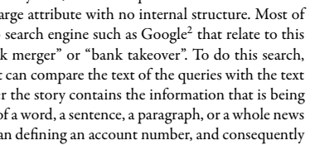
1.1 Information retrieval
Bank of information
critical piece of information in bank?
answer
queries
Design an algorithm to compare “piece of information” and information in bank!
retrieval
Not easy!
Core task: understanding and modeling how people compare texts, and designing computer algorithms to accurately perform this comparison!

Slide 8
1.2 Search engines
Definition: the practical application of information retrieval techniques to large-scale text collections
Examples: web search engine, desktop search engine, enterprise search engine

Slide 9

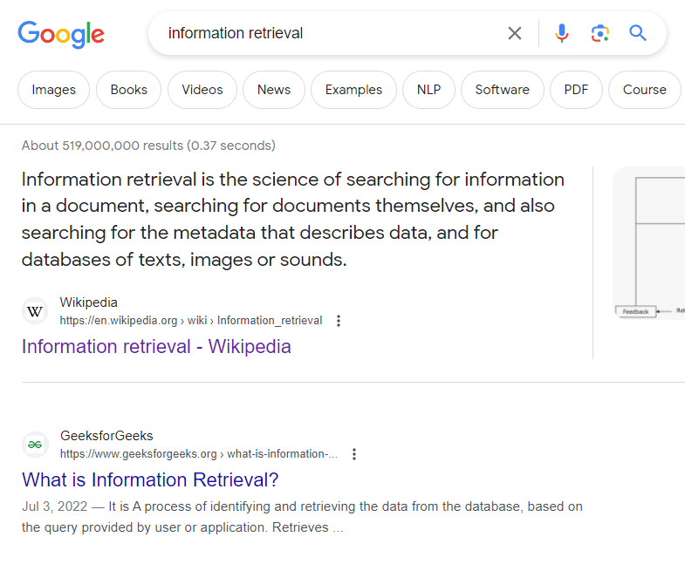

1.2 Search engines
An example of web search engine: Google - crawl, many terabytes of data, and then provide sub-second response times to millions of queries submitted every day from around the world
queries
answer
retrieval
Websites
Source: google.com

Slide 10
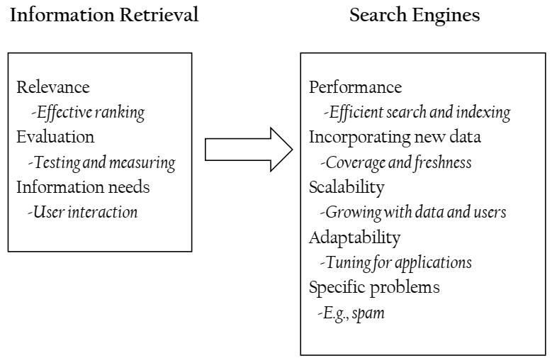
1.2 Search engines

Slide 11
1.3 Search engineers
primarily people trained in computer science, mostly with a systems or database background
few of them have training in information retrieval

Slide 12
1.3 Search engineers
Modify search engines
Extend search engines
Tune existing search engines
The majority of search engineers
Maintain search engines
Optimize content for search engines/deal with spam
Design and implement new search engines

Slide 13
1.4 Web Search
Compute score for each page
Eliminate duplicate and redundant
Identity a set of web pages containing the terms in queries
Generate summaries of remaining pages
queries
answer
retrieval
Websites
Source: google.com

Slide 14
1.5 Other Search Applications
Desktop search engine:
Provides search and browsing facilities for files stored on a local hard disk and possibly on disks connected over a local network
Requires greater awareness of file formats and creation times
Enterprise search engine:
Provides document management and search services across businesses and other organizations
Helps satisfy regulatory requirements regarding the retention of e-mail and other business communications

Slide 15
1.6 Other Information Retrieval Applications
Document routing, filtering, and selective dissemination
Text clustering and categorization
Summarization systems
Information extraction systems
Topic detection and tracking systems
Expert search systems
Question answering systems
Multimedia information retrieval systems

Slide 16
1.6 Other Information Retrieval Applications
Document routing, filtering, and selective dissemination
business
Việt Nam - Hàn Quốc: Dấu mốc lịch sử, đột phá tầm cao mới
politics
Subscribers
lifestyle

Slide 17
1.6 Other Information Retrieval Applications
Text clustering and categorization
Politics: sample1, sample2, …
Clustering/categorization system
Business: sample1, sample2, …
politics
Lifestyle: sample1, sample2, …
Việt Nam - Hàn Quốc: Dấu mốc lịch sử, đột phá tầm cao mới

Slide 18
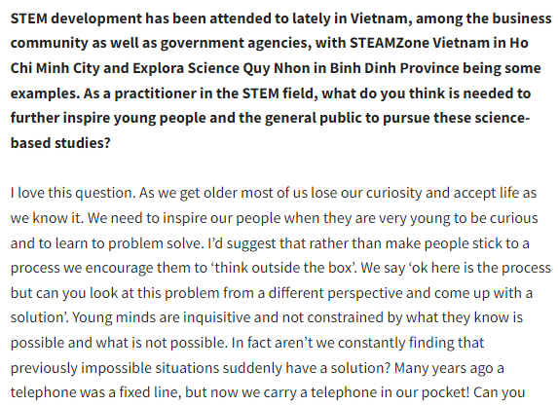
1.6 Other Information Retrieval Applications
Summarization systems: reduce documents to a few key paragraphs, sentences, or phrases describing their content
summarization system
Encourage creativity to create opportunities for young people
Source: english.thesaigontimes.vn

Slide 19
1.6 Other Information Retrieval Applications
Information extraction systems: identify named entities, such as places and dates, and combine this information into structured records that describe relationships between these entities

Slide 20
1.6 Other Information Retrieval Applications
Topic detection and tracking systems: identify events in streams of news articles and similar information sources, tracking these events as they evolve

Slide 21
1.6 Other Information Retrieval Applications
Expert search systems: identify members of organizations who are experts in a specified area

Slide 22
1.6 Other Information Retrieval Applications
Question answering systems integrate information from multiple sources to provide concise answers to specific questions

Slide 23
Exercise
Use the Web to find as many examples as you can of open source search engines, information retrieval systems, or related technology. Give a brief description of each search engine and summarize the similarities and differences between them.

Slide 24
Summary
Search engine is the practical application of information retrieval techniques to large-scale text collections
Text clustering and categorization techniques
Summarization systems: reduce documents to a few key paragraphs, sentences, or phrases describing their content
Topic detection and tracking systems: identify events in streams of news articles and similar information sources, tracking these events as they evolve

